Slide 1
Name : Solanki Rutvik Subject : Intership Project Name : Coffee Wala Project Gide : Meghna Mem Div : M1A4 (A)
College : College Of Computer Application
University : Silver Oak university

Slide 2
Product Discription
• Expression's unique roasting style flavored coffee .
Cold Coffee with chocolate ice-cream Coffee with cinnamon stick Hot coffee . Black coffee Sugar Free French Vanilla Coffee Cream

Slide 3
Product
Coffee
Tea
Black Coffee
Green Coffee
Redeyes Coffee
Gujarati Tea
Special Tea
Family Tea

Slide 4


Special coffee
Black Coffee
Green Cooffe

Slide 5
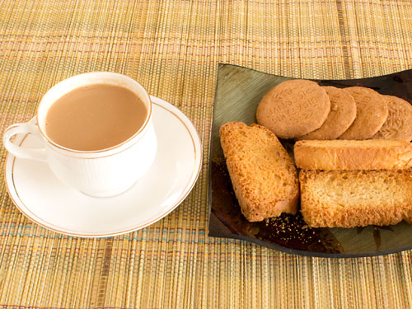

Special Tea
Hot Tea
Gujarati Tea

Slide 6
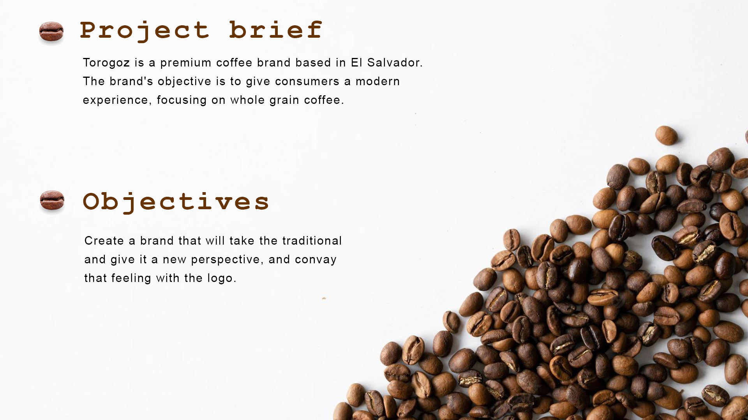

Slide 7
Benifits
Coffee is a potent source of healthful antioxidants. ...
Caffeine provides a short-term memory boost. ...
Coffee may help protect against cognitive decline. ...
Coffee is healthy for your heart. ...
Coffee may help curb certain cancers. ...

Slide 8
